Slide 1
WELCOME
Name :-Vedita Santosh Mhatre
Enrollment no :-EBEON0722627266
Course :-Java full stack

Slide 2
Hospital Management System
Team Members
Name | Enrollment Number
Shrividya Veggalapu | EBEON0722630563
Katyayani Kommoju | EBEON0722629133
K Asha Nandini | EBEON0722628531
Vedita Santosh Mhatre | EBEON0722627266

Slide 3
Hospital Management System
Project Modules:-
Modules | API
Admin | SSO
Doctor and Patient | Chat bot
Billing and Reports | Payment
Inventory/Laboratory/Infrastructure | Video Demonstration
Support services-Appointment/Women Care/Ambulance/Pharmacy/Healthcare | Voice Assistance

Slide 4
Hospital Management System
Hospital management system provides a common source information od patient’s health history. The system stores data and handles the data.
Inventory and laboratory modules handle by admin or hospital staff.
Only admin has access of both modules.
Keeping the data secure and up to date is a main goal of HMS.
Modules:-
Inventory
Laboratory

Slide 5
Module 1 :- Inventory (Hospital Inventory)
Inventory is the goods and materials. Inventory management is the part of supply chain is automated for the convenience of the staff that can concentrate on patients need firstly.
Inventory Management System is used to keep inventories up to date.
Assess the hospital inventory.
Reviews last inventory stock.
Analyse sales
Identify items to repurchase or retire.

Slide 6
Module 2 :- Laboratory (Laboratory Test)
A medical laboratory is a laboratory where test carried out to obtain information about the health of a patient to aid in diagnosis, treatment and prevention of disease.
We can add Laboratory test as per the patient requirements .
It keeps the records of patients test details.
The records of laboratory test of patients gets saves by unique Id numbers.
Admin can handle all operations related to laboratory test.
It helps to generate reports of patient to diagnose the disease.

Slide 7
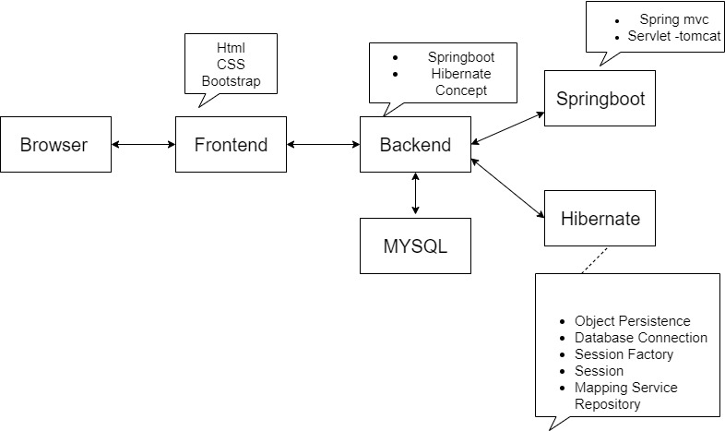
Technical Architecture :

Slide 8
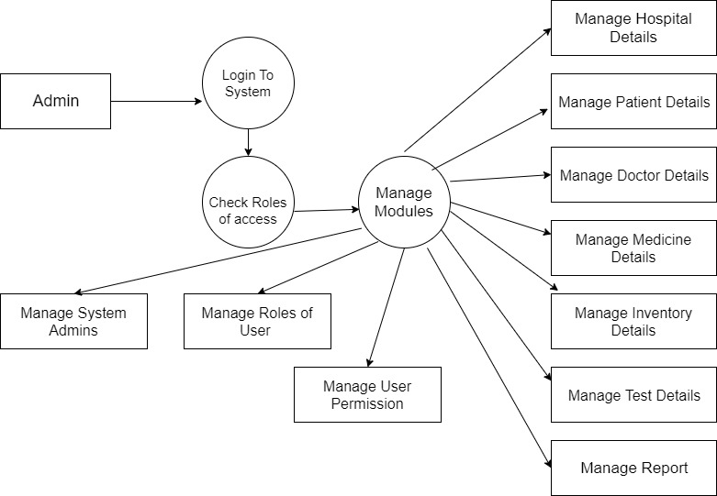
Data Flow Diagram : HMS

Slide 9
Features of modules
Inventory:
Alerts Regarding the inventories details
Reorder stock details of stock
Improved inventory control
Support management
Laboratory:
Patients test results.
Automated Reporting.
Automated follow up scheduling.
Medication and suggested medicine.

Slide 10
Conclusion :-
Implementation of Hospital Management System project helps to store all the kinds of records, provide co-ordination and user communication, implement policies , improve day to day operations , arrange the supply chain, manage financial and human resources and market hospital services.

